Slide 1
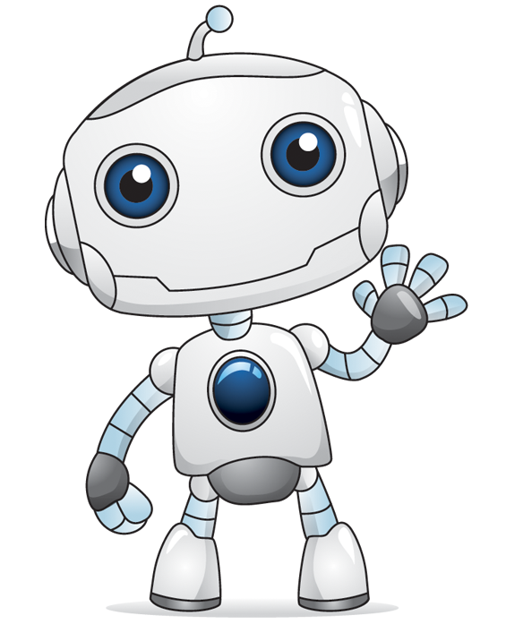
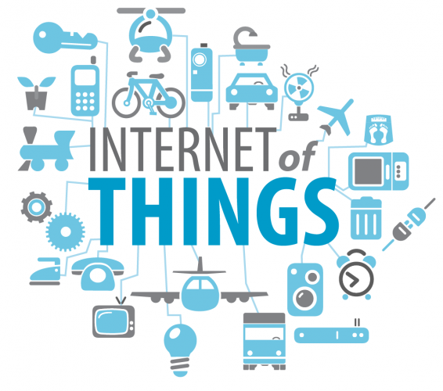
Bit more than Bot 04/26/2018

Slide 2
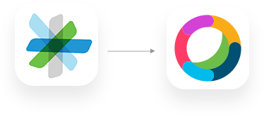
Cisco Spark is now WebEX Teams
https://www.webex.com/products/teams/index.html
New Webex for developers is here https://developer.webex.com/blog/blog-details-9738.html

Slide 3
Getting Started
Beginner
Expert
What is Cisco WebEX Teams?
What is IoT ?
Building with Cisco WebEX
Building with IoT Kits
IoT Kit - report Temperature and Humidity
ChatBots with Dialogflow
Python & REST API
https://tinyurl.com/iothacker
Notes:
Today we will talk about IoT, Cisco Spark
Introduce to some beginner level programming on Cisco Spark & IoT Kits
We will leave Expert level exercise for you to try for rest of the day.

Slide 4
Getting Started What is Spark?

Slide 5

Cisco Spark – User Interface
Dashboard walk-through
Visit Cisco Spark on your Web browser https://web.ciscospark.com/
Create New Room https://web.ciscospark.com/rooms/new
Add more people by Email
Notes:
Cisco Spark is a complete business collaboration service from the Cisco cloud that enables you to message, meet, or call anyone, anywhere, and anytime.
Add students to Event Spark room
Get Students to login to web.ciscospark .. Show them Navigation to add multiple new rooms/ new people to a room (later students will do these using API).

Slide 6
Getting Started What is IoT?

Slide 7

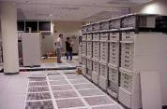





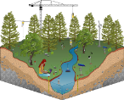
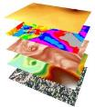




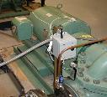




IoT is driving Shift In End Points - Users to Things
From Consumer
Tablets, Laptops, Phones
Human Interactions
To Enterprise & Operational Technologies
Sensors, Smart Objects, Device Clustered Systems
Machine to machine interactions
Energy Saving Smart Grid
Transport and Connected Vehicles
Intelligent Buildings
Improve Productivity
Analytics and Modelling
Safety & Security
Precision Agriculture
Healthcare
Predictive Maintenance
Smart Home S+CC
Notes:
Talk about trends in industry how end-clients shifting from Mobile/ PC to IoT devices

Slide 8
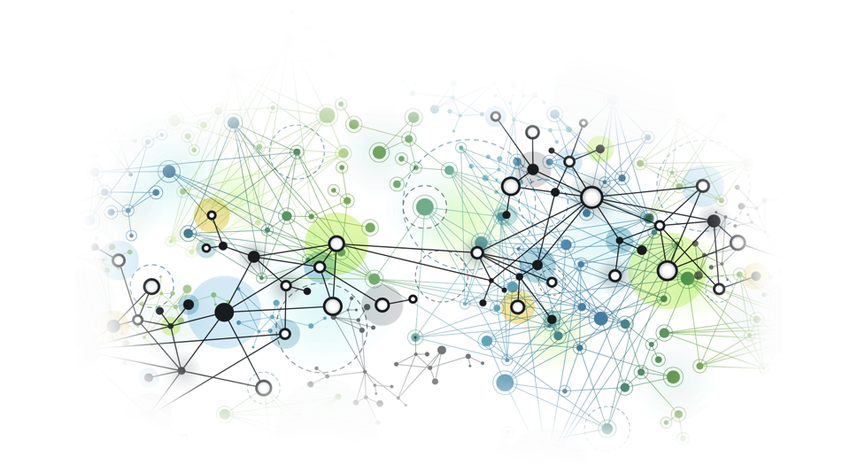



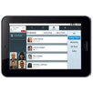

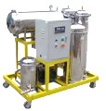



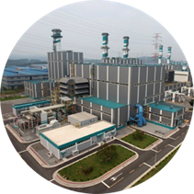



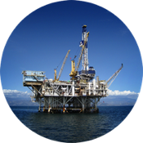




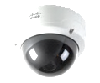
IoT generate Massive, Messy Data Everywhere
50B
Devices Connected by 2020
Source: Cisco Consulting Services
8
Notes:
Introduce the problem in the IoT world - About 50 Billion devices will generate massive amount of Data ..

Slide 9
Challenge- Tons of Data – Fast decision
In One Day
1.1 Billion
Data points generated by sensors
In One Week
500 Gigabytes
Data generated by an offshore oil rig
In One Day
1,000 Gigabytes
Data generated by an oil refinery
Every 30 Minutes per flight
10,000 Gigabytes
Data generated by a jet engine (e.g., PW1000G)
In One Day
2.5 Billion Gigabytes
Data generated worldwide
In The Past 2 years
90% of the world’s data
Has been created
10110101100111
9
Notes:
Samples of how IoT Data will look

Slide 10




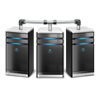


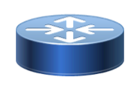
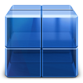

Solution - IoT Smart Edge
IoT Computing is a New Computing Paradigm
IoT Computing is a New Computing Paradigm
Taking Data to the Processing
IoT Device
Cloud
Cloud
Big Data
Analytics
Applications
Data
Processing
Taking Processing to the Data
IoT Device
Edge Node
Fog Node
Cloud
Data
Data
Data
Processing
Processing
Processing
18
Notes:
Edge compute is the new way of compute where data is processed in the edge and not on centralized DC
Today students will work on the IoT Kits .. That are typical example of Edge-compute. In real world we use more robust secure platforms like Cisco IR829, CGR1240 etc ( secure/ruggedized/ weather-proof)

Slide 11
Today we will Program the IoT devices to perform some Edge Compute.

Slide 12
Beginner Level Build with IoT

Slide 13
Welcome!
Today we will hack some code on to the Photon Board and push this data to the internet

Slide 14
Photon
The Photon is an amazing piece of low cost gear with built in Wifi.
Think of it like a turbo charged Arduino.

Slide 15
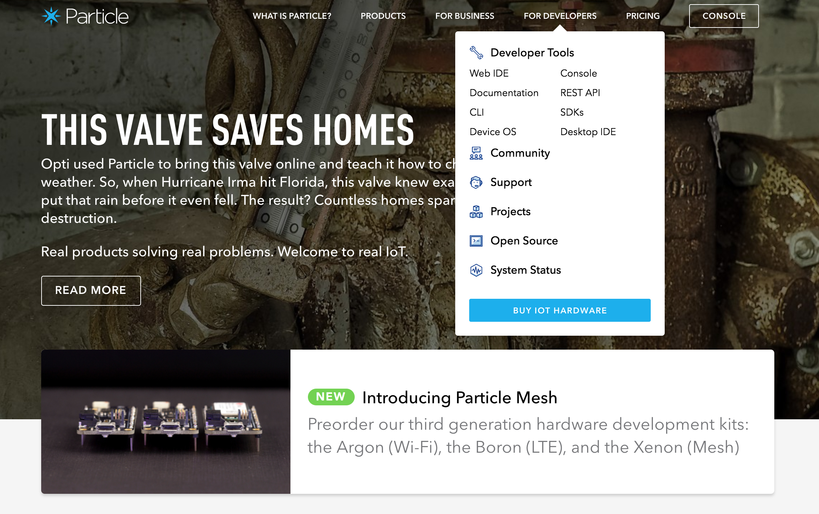
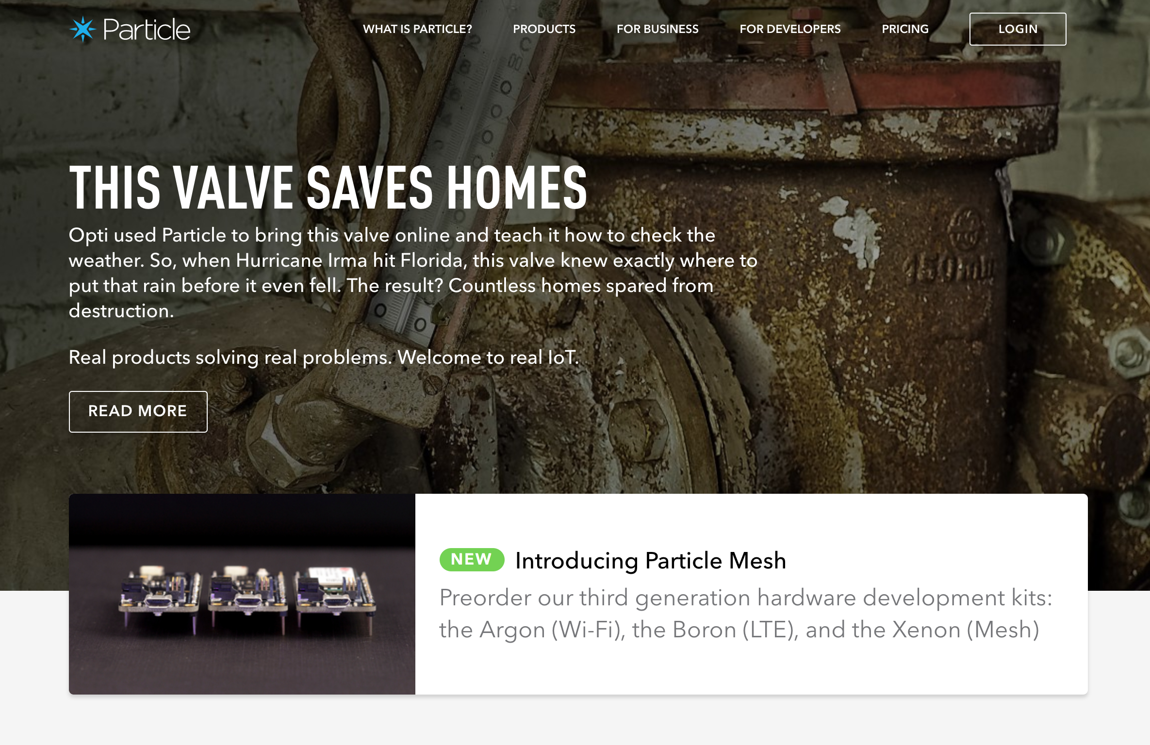
Step1) Login to particle.io
Step 2) Navigate to Web IDE
“For Developers” > “Web IDE”
Username: ciscoiot2018+<Pod>@gmail.com
Password: Cisco123/ Jeffcon2018
Login
Wed IDE

Slide 16
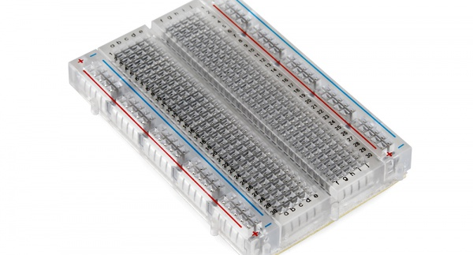
How Breadboards work

Slide 17
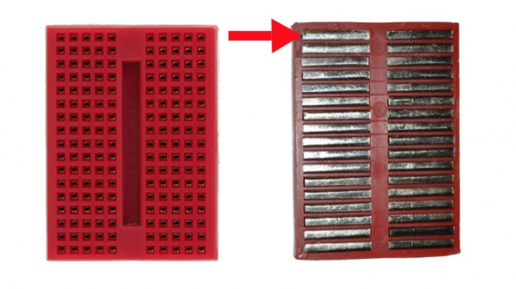

Slide 18
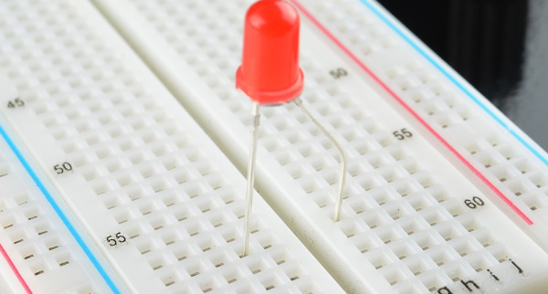

Slide 19
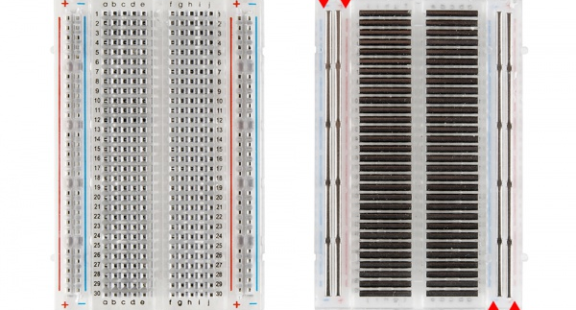

Slide 20
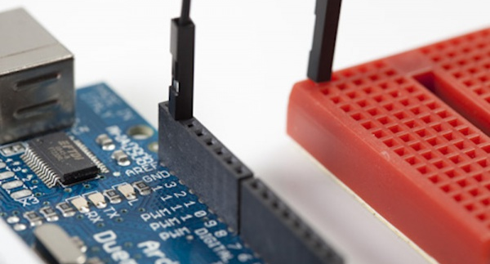

Slide 21
LED
Light Emitting Diode’s
They run at ~2V.
Use a resistor because the Photon is 3.3V.

Slide 22
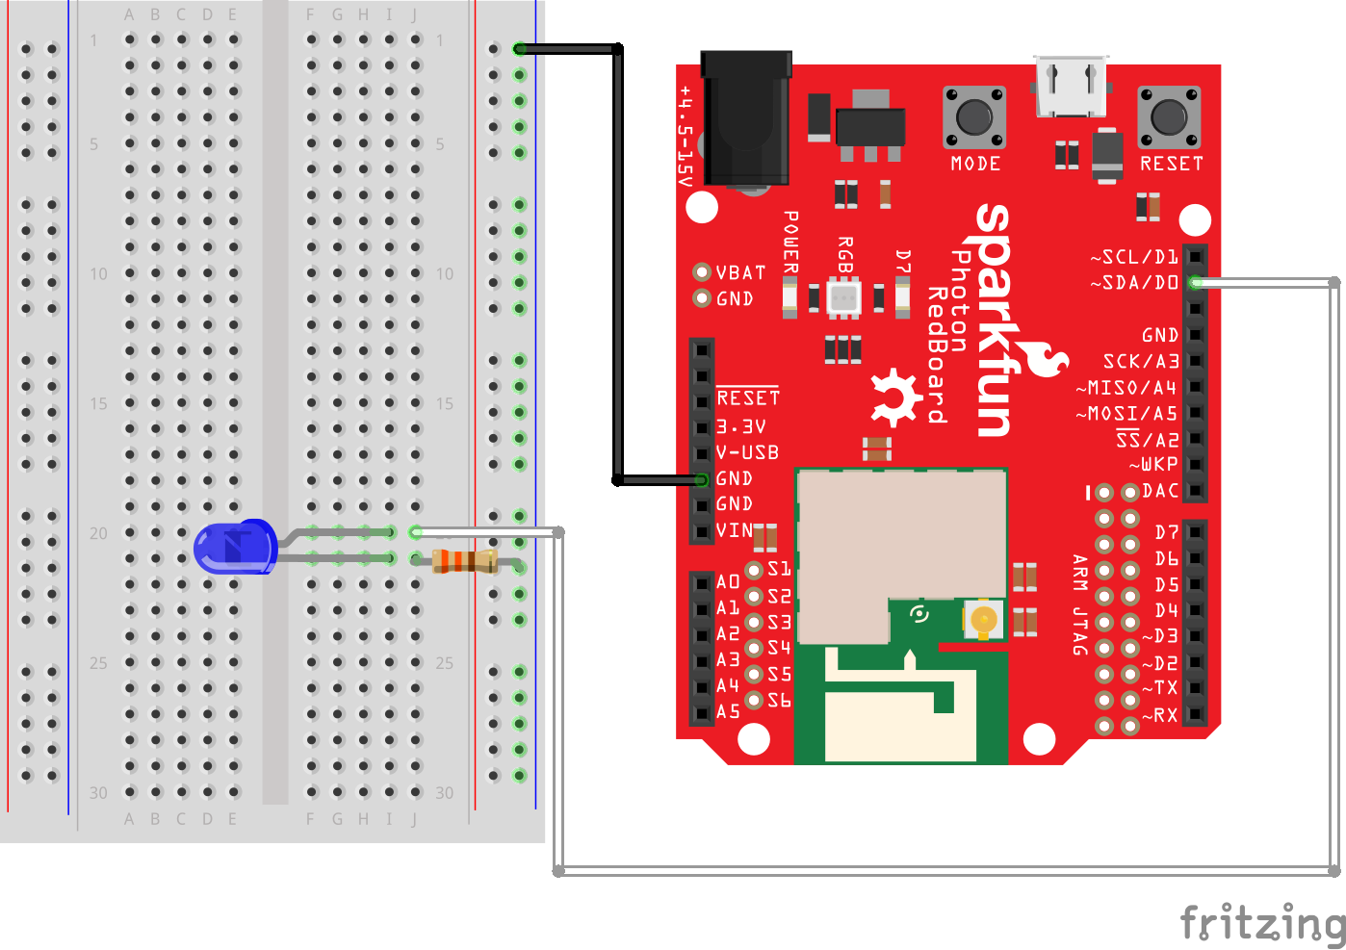
Blink

Slide 23
Blink
int led = D0; // LED is connected to D0
// This routine runs only once upon reset
void setup()
{
pinMode(led, OUTPUT); // Initialize D0 pin as output
}
// This routine loops forever
void loop()
{
digitalWrite(led, HIGH); // Turn ON the LED
delay(1000); // Wait for 1000mS = 1 second
digitalWrite(led, LOW); // Turn OFF the LED
delay(1000); // Wait for 1 second
}

Slide 24
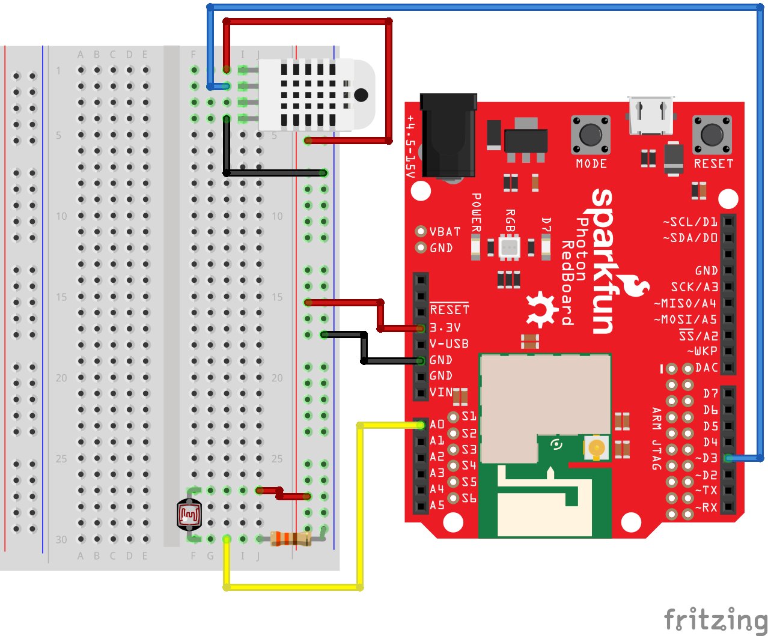

Temperature & Humidity

Slide 25
Have fun, but don’t break them. ☺

Slide 26
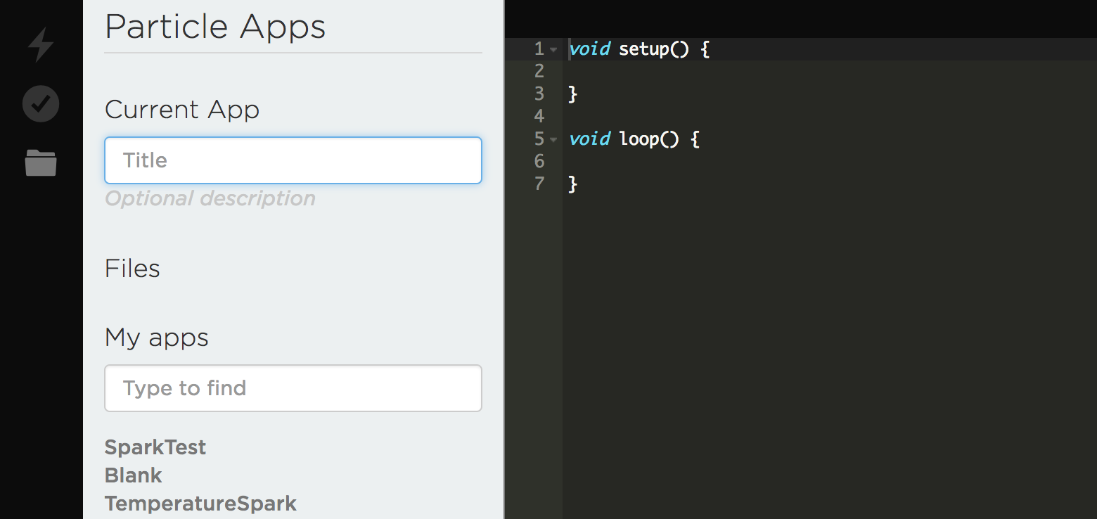
Writing your code and compiling in Particle
Step (4) Flash Code to IoT Kit
Step (3) Verify code
Step (2) Save
Step (1) Write your Code here

Slide 27
Try the IoT Exercises 1 & 2 Cisco IoT Hackathon.pdf https://tinyurl.com/iothacker

Slide 28
Beginner Level Build Bot with Cisco WebEX Teams

Slide 29
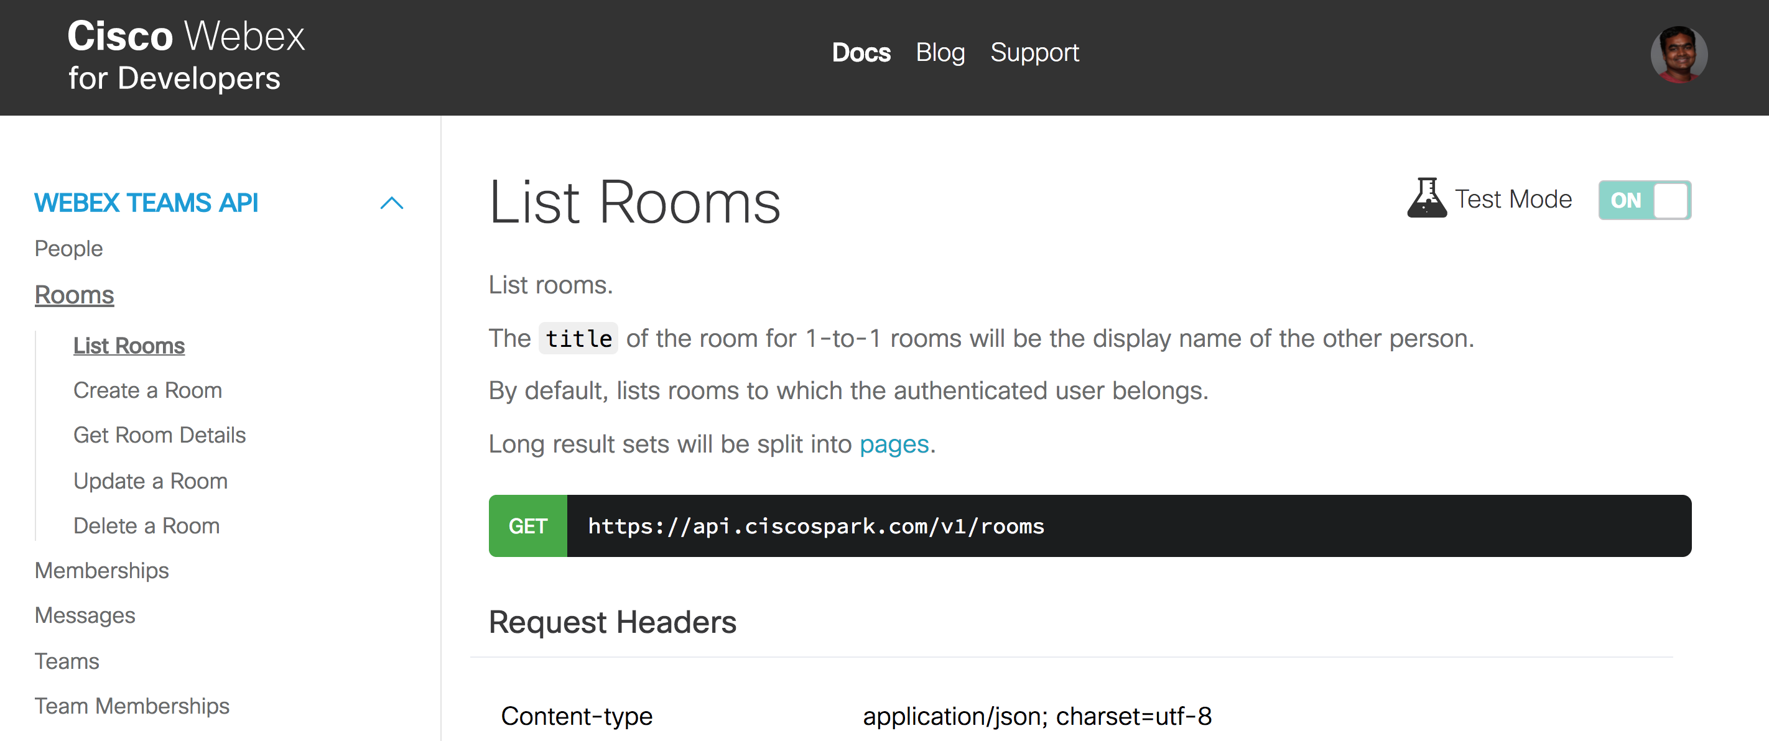
WebEX API Documentation: https://developer.webex.com
Step 1 – Go to Docs
Step 2 – List Rooms

Slide 30
Lets review what just happened -What is REST API

Slide 31
REST Web Service
What is a Web Service?
A way for two systems to communicate through a defined interface.
Two major types of Web Services – REST or SOAP
What is a REST Web Service?
REST is an architecture style for designing networked applications.
A REST web service is a web service that is as easy to call as making an HTTP request.
RESTful interfaces often offer the CRUD operations
Notes:
REST stands for Representational State Transfer. It relies on a stateless, client-server, cacheable communications protocol (ex. HTTP)

Slide 32

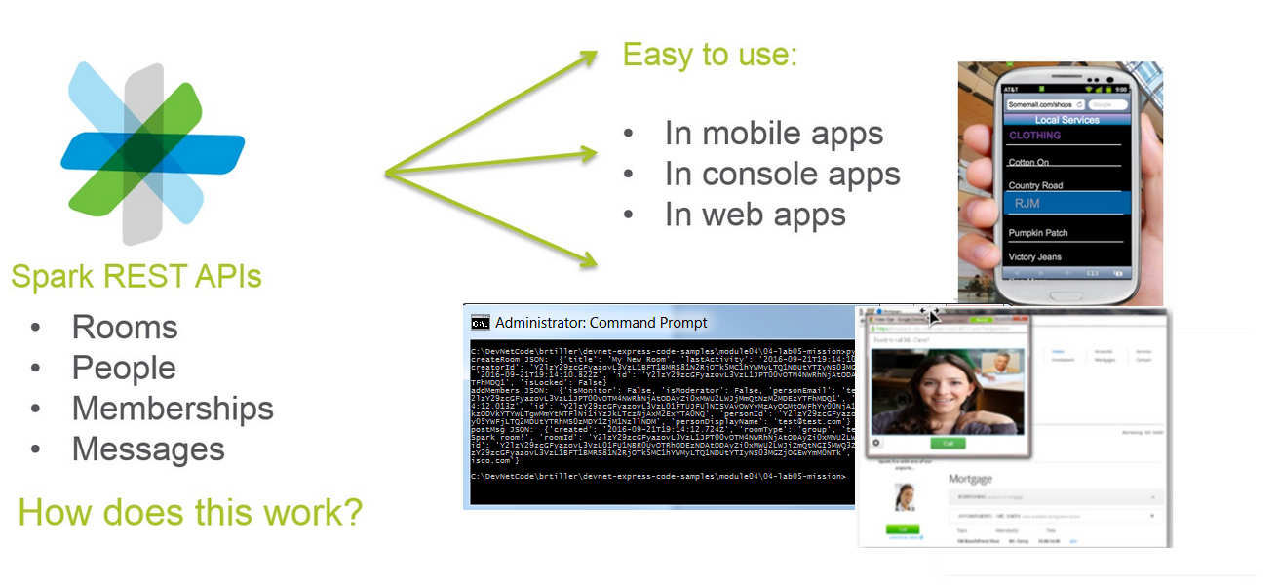
What is so great about REST?

Slide 33
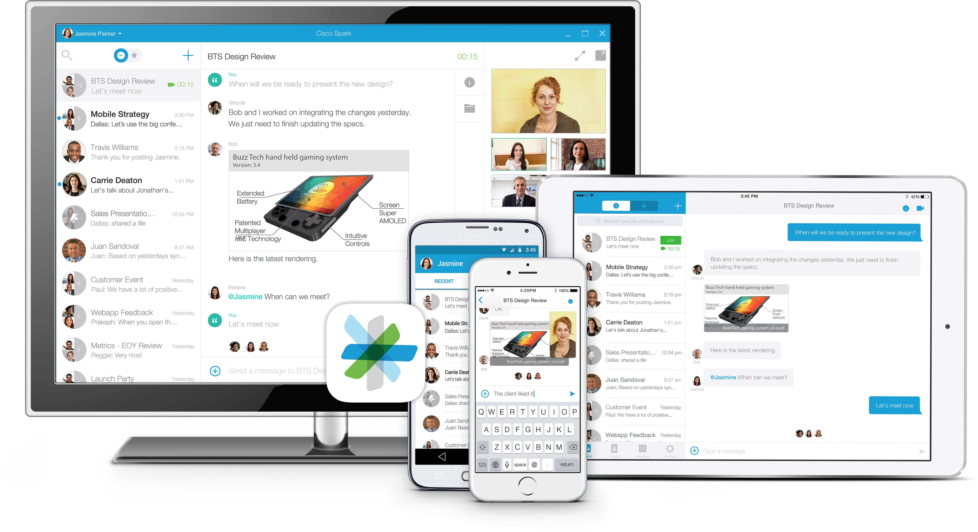

WebEX APIs Extend Cisco Collaboration Cloud
‘Your App’
Now with Cisco Collab!
GET
/People
POST
/Memberships
PUT
/Rooms
DELETE
/Messages
/Webhooks

Slide 34
Expert Level Build Your own Program Chatbot IoT program Python API

